Slide 1
Kendal Engineering Society
Ian Norton

Slide 2
What are we talking about?
Connection
Telephone directories
Call routing
Extension numbers
Languages
Notes:
Connection – how do we get a connection to our house?
Telephone directories?
Call routing – how does that connect to a server?
Extension numbers – what's a service?
Languages – what's a protocol?

Slide 3
This isn't a lecture!
Ask questions as you wish

Slide 4
Connection
Wire pair
Telephone number
Technology unchanged for ~100 years

Slide 5
What does a typical
connection look like?

Slide 6
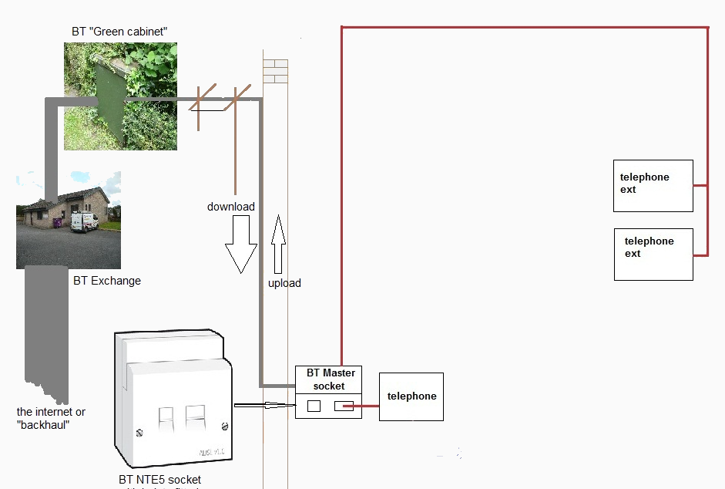
Connection
Notes:
This is our traditional model of telephony.
Where does the internet fit in?

Slide 7
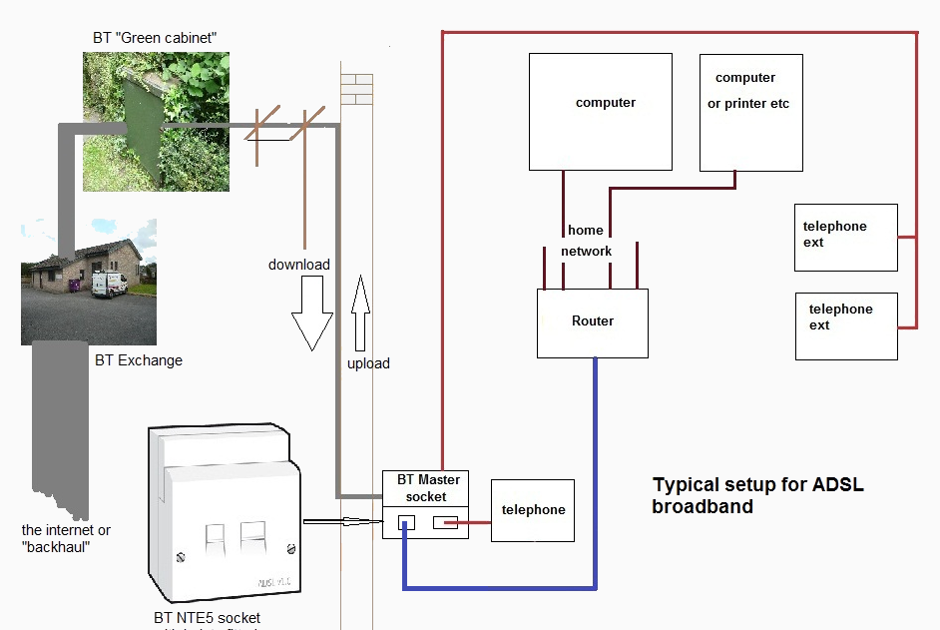
Connection

Slide 8
Wired is not
the only solution

Slide 9
Wired is not
the only solution
The most common

Slide 10
Connection
Wired
Wireless
Optical
Notes:
Copper wire
Wireless one of licence free, licenced and satellite
Optical via fibre optic but also by line of sight laser links

Slide 11
Connection
So what's new?

Slide 12
Connection
So what's new?
Aluminium wire
Diameter of copper changed

Slide 13
Connection
So what's new?
Aluminium wire
Diameter of copper changed
Length of line shortened

Slide 14
How can the line
get shorter?!

Slide 15
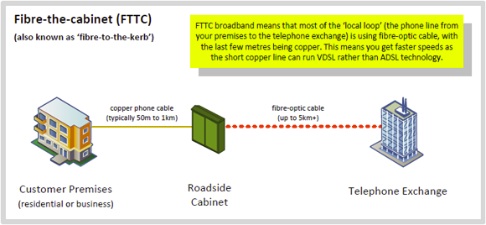
Connection

Slide 16
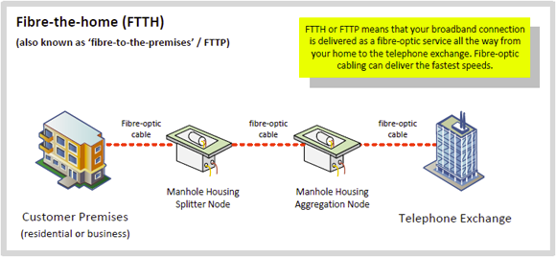
Connection

Slide 17
Connection

Slide 18
So how is this relevant?!

Slide 19
Connection
Telephone number

Slide 20
Connection
Telephone number
IP address

Slide 21
Connection
IP address is a unique number
Just like a telephone number
Your computer calls another computer
They talk!

Slide 22
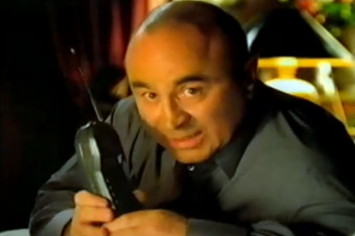

Slide 23
It's good to talk....

Slide 24
Connection
IP address:
    32 bit number
    4,294,967,296 addresses worldwide

Slide 25
Connection
IP address:
    32 bit number
    4,294,967,296 addresses worldwide
Example:
    173.194.34.102

Slide 26
Connection
IP address:
    32 bit number
    4,294,967,296 addresses worldwide
Example:
    173.194.34.102
Worldwide addresses are running out

Slide 27

Notes:
Who remembers this?!

Slide 28


Slide 29
Connection
IP v6 address:
    64 bit number
    42 unecillion addresses worldwide (4.2 x 10^37)

Slide 30
Connection
IP v6 address:
    64 bit number
    42 unecillion addresses worldwide (4.2 x 10^37)
Example:
    2001:0db8:85a3:0000:0000:8a2e:0370:7334

Slide 31
Connection
IP v6 address:
    64 bit number
    42 unecillion addresses worldwide (4.2 x 10^37)
Example:
    2001:0db8:85a3:0000:0000:8a2e:0370:7334
Mind blowing number of addresses

Slide 32
Remember the numbers?!

Slide 33
Telephone directories
Remembers the numbers?
    Doesn't work for most people!

Slide 34
Telephone directories
Remembers the numbers?
    Doesn't work for most people!
Address book
Telephone directories

Slide 35
Telephone directories
Domain Name Services (DNS)
    The internet telephone directory

Slide 36
Telephone directories
Domain Name Services (DNS)
    The internet telephone directory
www.google.co.uk
    www.google.co.uk has address 173.194.41.127

Slide 37
Call routing
Dial a number
Exchanges route to destination

Slide 38
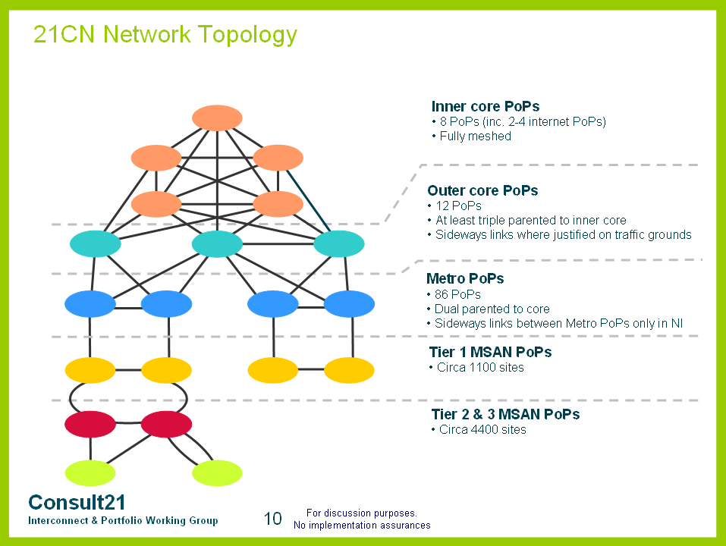
Connection
Notes:
Not much has changed since the original creation of the telephone network.

Slide 39
The internet?

Slide 40
The internet?
works pretty
much the same

Slide 41
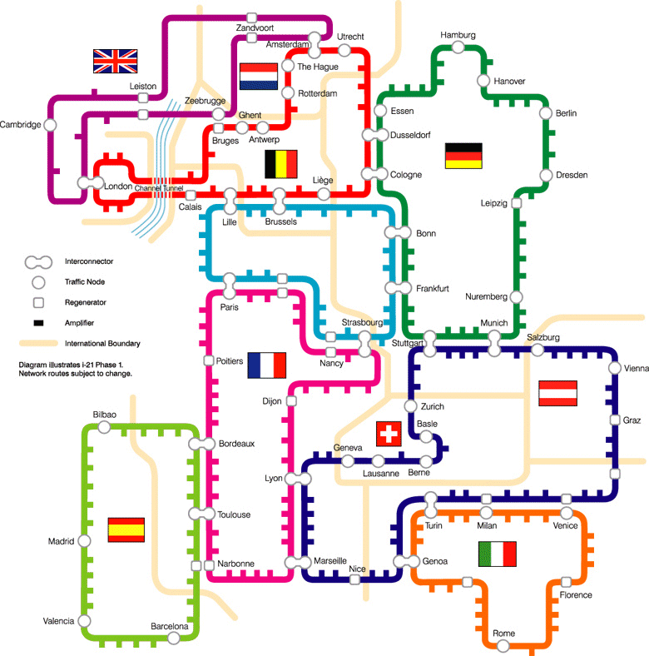

Slide 42
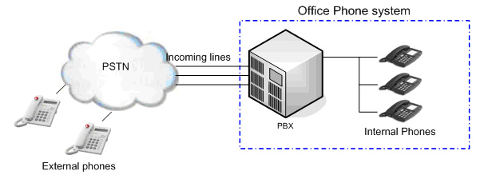
Extension numbers

Slide 43
Extension numbers
Private Branch eXchange = Computer
Extension = Port

Slide 44
Extension numbers
25 – email sending
80 – web server
443 – secure web server
993 – email retrieval

Slide 45
Languages
Each port has a language
Standards based protocols
    Hypertext Transfer Protocol HTTP – web servers
    Simple Mail Transfer Protocol (SMTP) – email sending
    Internet Message Access Protocol (IMAP) – email retrieval

Slide 46
To recap
You enter www.google.co.uk
Browser looks up the address using DNS
Connects to 173.194.41.127 port 80
Uses Hypertext Transfer Protocol (HTTP)
  requests web page
Page returned to client
  Hypertext Markup Language (HTML)
  Tells the browser how to display the information

